Slide 1
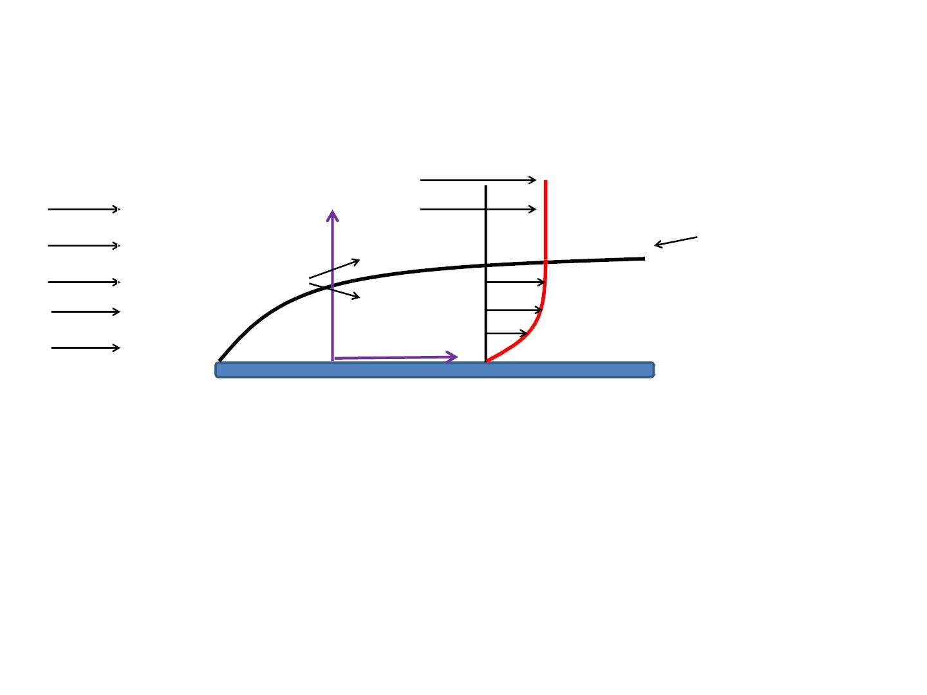
External Incompressible Viscous Flow – Boundary Layer
FreestreamꢀVelocity,ꢀU∞
Approach
Velocity
V Flow
y
BoundaryꢀLayerꢀ
ofꢀThickness,ꢀꢀδ
Inviscid
Viscous
x
v_{x}ꢀ=ꢀfꢀ(x,ꢀy)
Flow over a flat plate
v_{x}ꢀ=ꢀfꢀ(x,ꢀy)
v_{x}ꢀ=ꢀꢀU∞
Viscousꢀ2DꢀflowꢀinsideꢀBL
InviscidꢀflowꢀoutsideꢀBL
v ꢀ=ꢀ0.99U ꢀ
atꢀyꢀ=ꢀδ
x
∞
δ - boundary layer thickness

Slide 2
Integral Equation
${\frac{dN}{dt}|}_{system}=\frac{∂}{∂t}\int_{CV}{η}ρd∀+\int_{CS}{η}ρ\overset{⃑}{V.}\overset{⃑}{dA}$
Displacement and Momentum Thicknesses
$$δ^{∗}=\int_{0}^{δ}{\left(1−\frac{v_{x}}{U}\right)}dy, θ=\int_{0}^{δ}{\frac{v_{x}}{U}\left(1−\frac{v_{x}}{U}\right)}dy$$
MI Equation
$\frac{τ_{w}}{ρ}=\frac{d}{dx}\left(U^{2}θ\right)+δ^{∗}U\frac{dU}{dx}$

Slide 3
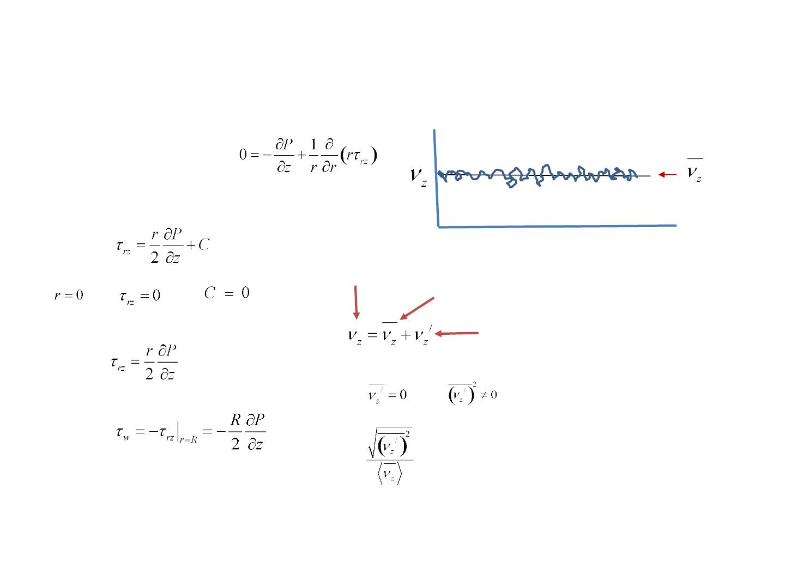
Turbulent Flow
Fullyꢀdevelopedꢀsteadyꢀflow
Zꢀcomponentꢀofꢀ
equationꢀofꢀmotion
t
Instantaneousꢀvelocity
Timeꢀsmoothedꢀvelocity
Fluctuatingꢀcomponentꢀofꢀ
velocity
=ꢀMeasureꢀofꢀTurbulence

Slide 4
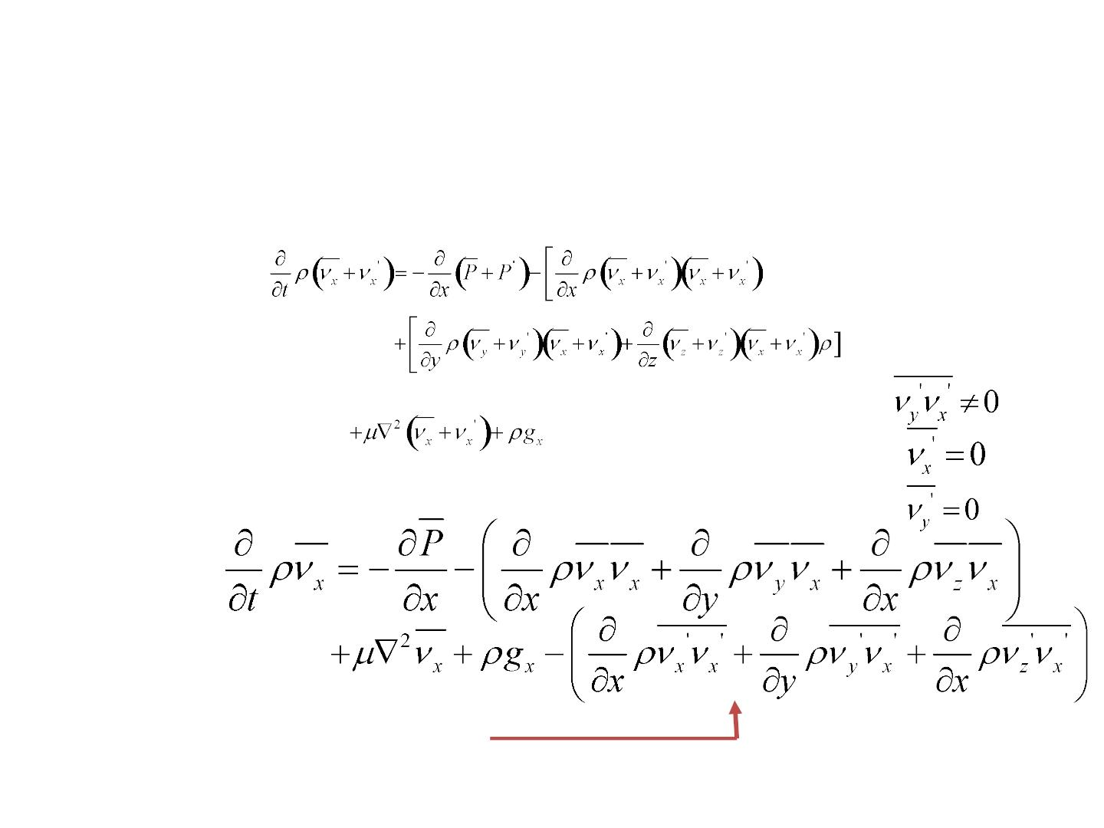
Turbulent flow
UsingꢀNSꢀequation
xꢀcomponent
Takeꢀtimeꢀaverage
Reynold’sꢀstresses

Slide 5
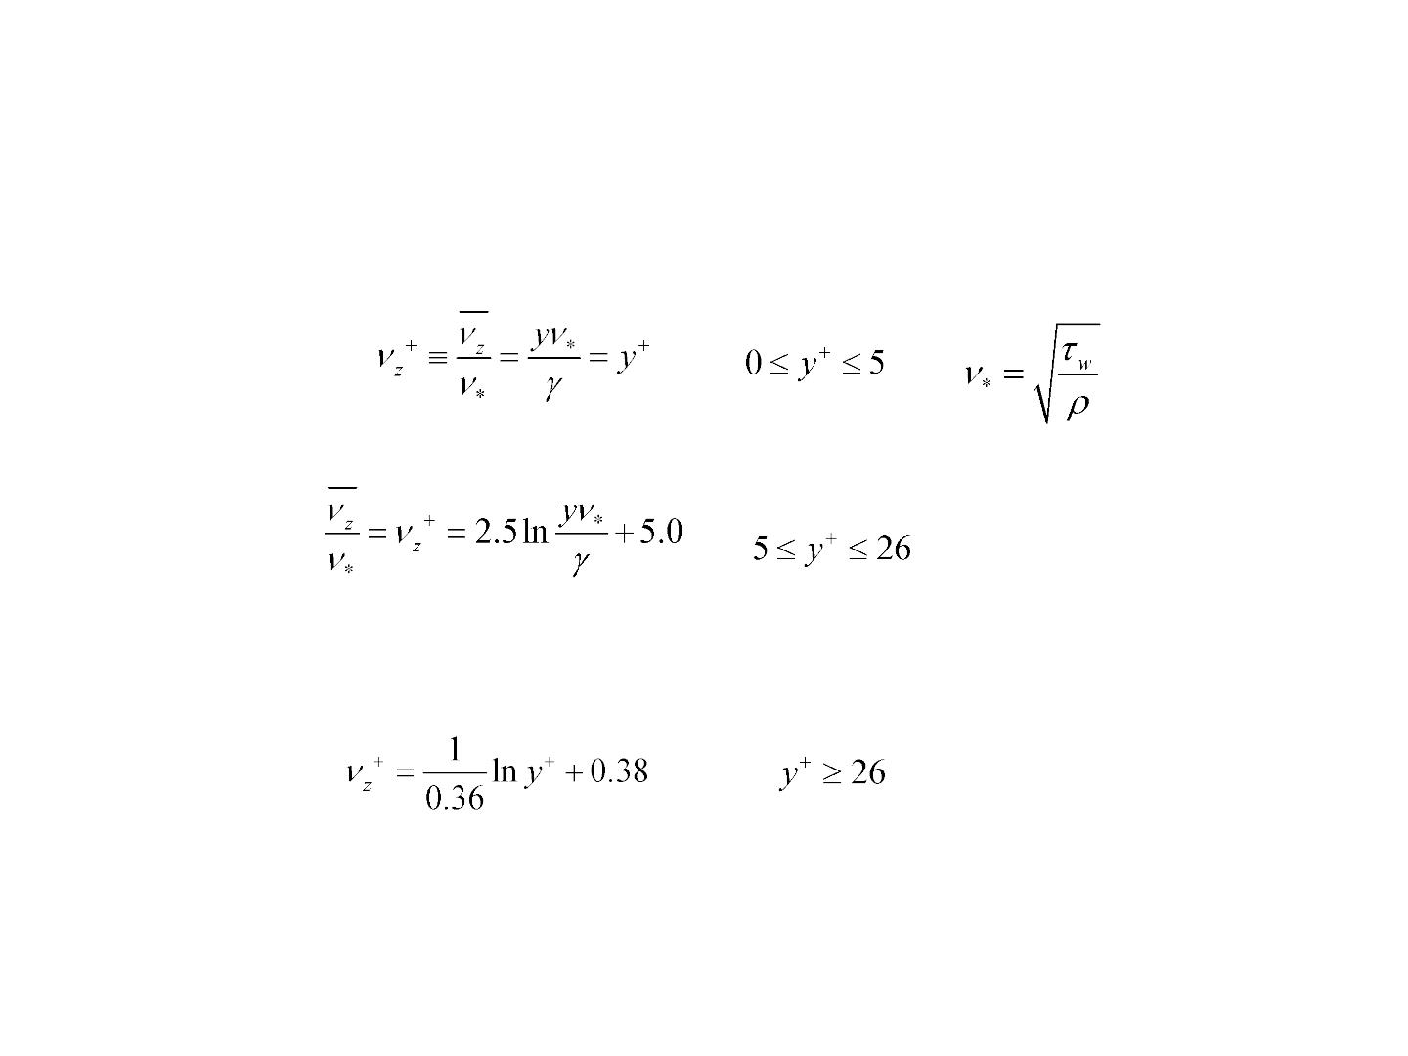
Turbulent Flow contd.
Universalꢀvelocityꢀprofile
Viscous
ꢀsublayer
=ꢀFrictionꢀvelocity
Transitionꢀ
region
Turbulentꢀcore

Slide 6
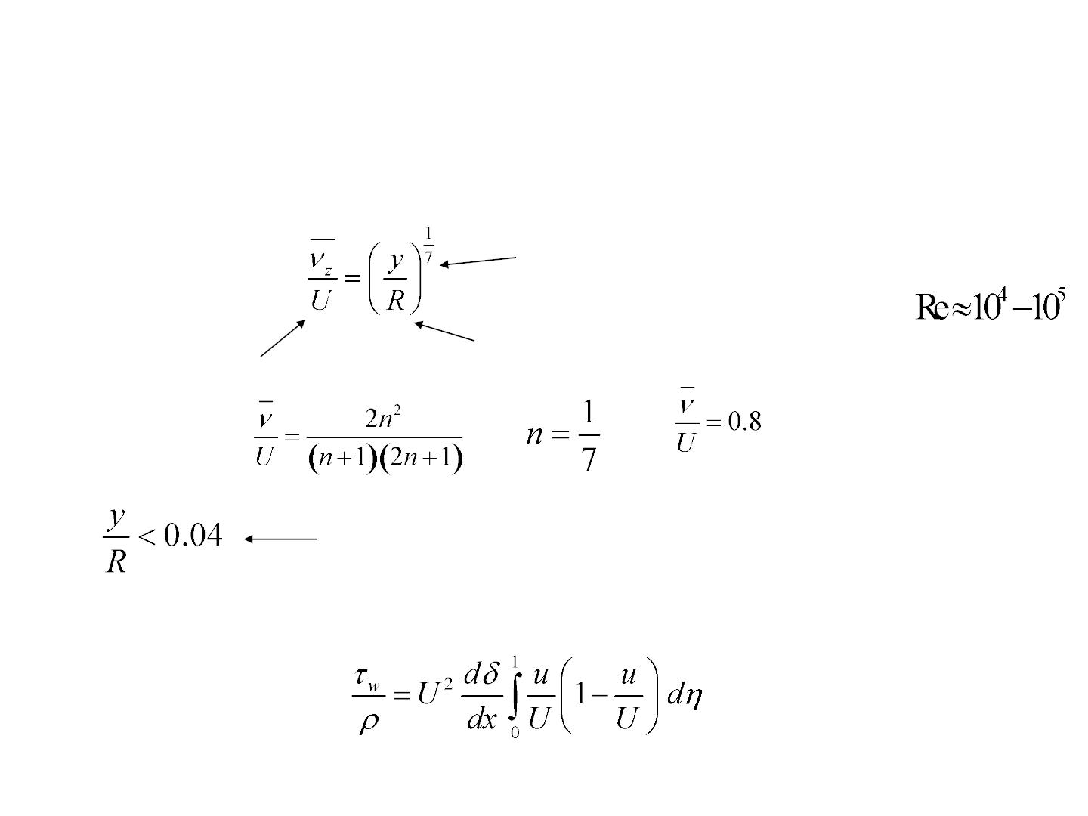
Turbulent Flow contd.
Universalꢀvelocityꢀprofile
Distanceꢀfromꢀ
theꢀwall
Powerꢀlawꢀequation
1/7thꢀpowerꢀlawꢀprofile
Centerlineꢀ
velocity
Radius
Infiniteꢀvelocityꢀgradientꢀ Doesꢀnotꢀgiveꢀzeroꢀ
atꢀtheꢀwall
slopeꢀatꢀtheꢀcenterline

Slide 7
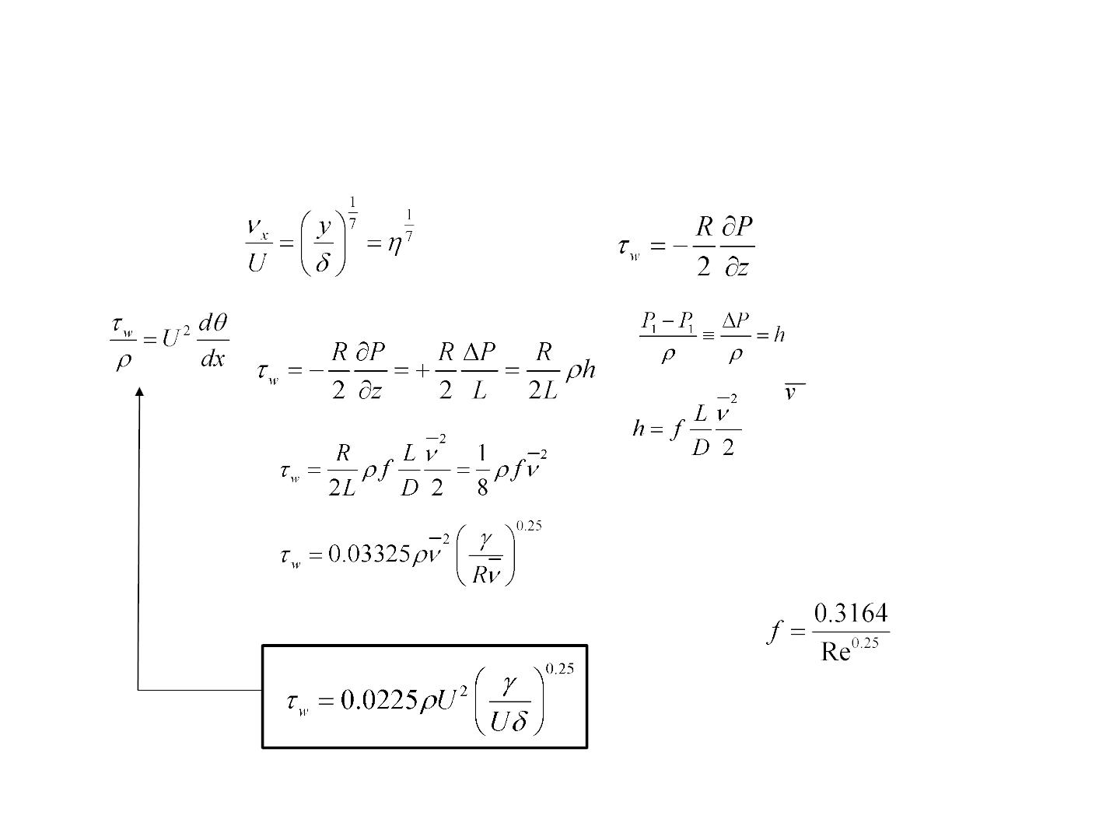
TurbulentꢀBoundaryꢀLayers
MIꢀeqn
hꢀ=ꢀheadꢀlossꢀforꢀaꢀ
horizontalꢀpipe
=ꢀAverageꢀflowꢀ
velocity
Blasiusꢀcorrelation
Usingꢀ1/7thꢀpowerꢀlaw

Slide 8
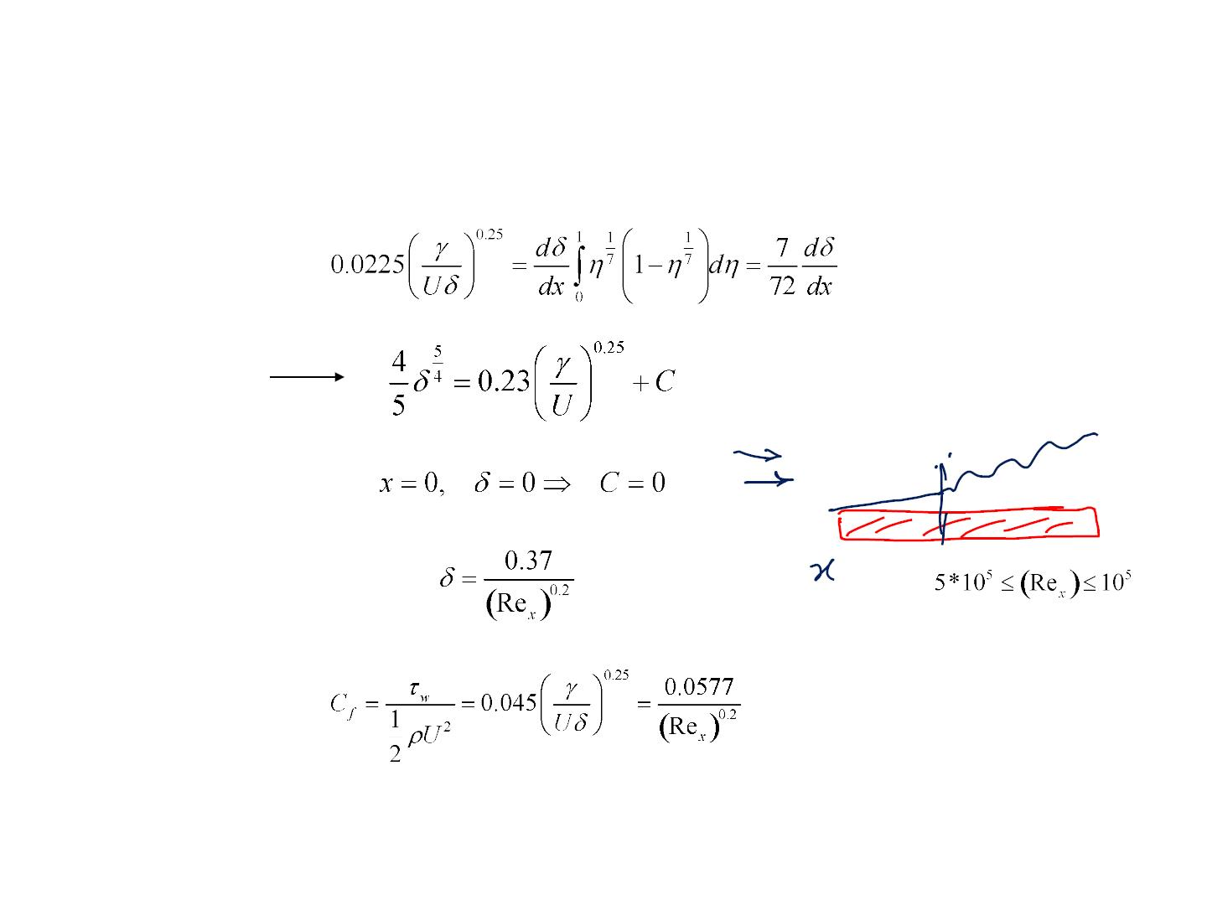
TurbulentꢀBoundaryꢀLayers
MIꢀ
equation
BC

Slide 9
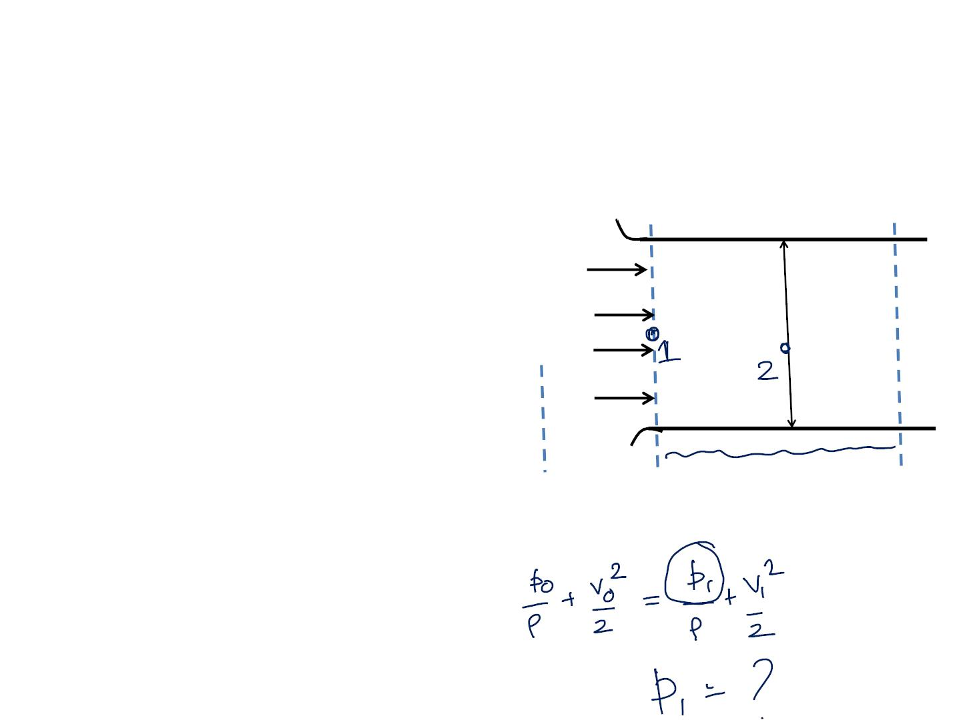
Flowꢀ ofꢀ airꢀ (ꢀ ꢀ =ꢀ 123ꢀ kg/m3)ꢀ developsꢀ inꢀ aꢀ
flatꢀ horizontalꢀ ductꢀ followingꢀ aꢀ wellꢀ
roundedꢀentranceꢀsection.ꢀTheꢀductꢀheightꢀisꢀ
Hꢀ =ꢀ 300ꢀ mm.ꢀ Turbulentꢀ boundaryꢀ layerꢀ
growsꢀonꢀtheꢀductꢀwalls,ꢀbutꢀtheꢀflowꢀisꢀnotꢀ
yetꢀ fullyꢀ developed.ꢀ Assumeꢀ thatꢀ theꢀ
velocityꢀ profileꢀ inꢀ eachꢀ boundaryꢀ layerꢀ isꢀ
givenꢀ byꢀ u/Uꢀ =ꢀ (y/δ)^{1/7}.ꢀ Theꢀ inletꢀ flowꢀ isꢀ
uniformꢀ withꢀ Vꢀ =ꢀ 10ꢀ m/sꢀ atꢀ sectionꢀ 1.ꢀ Atꢀ
sectionꢀ 2,ꢀ theꢀ boundaryꢀ layerꢀ thicknessꢀ onꢀ
eachꢀwallꢀofꢀtheꢀchannelꢀisꢀδ₂ꢀ=ꢀ100ꢀmm.ꢀ
V₁ꢀ=ꢀ10ꢀm/s
^{V}o^{ꢀ=ꢀ0}
P_{o}ꢀ=ꢀ0
Hꢀ=ꢀꢀ300ꢀmm
(a)ꢀShowꢀthatꢀforꢀthisꢀflow,ꢀδ*ꢀ=ꢀδ/8.
(b)ꢀ Evaluateꢀ theꢀ staticꢀ gageꢀ pressureꢀ atꢀ
sectionꢀ2
(c)ꢀ Findꢀ theꢀ averageꢀ wallꢀ shearꢀ stressꢀ
betweenꢀtheꢀentranceꢀandꢀsectionꢀ2ꢀatꢀLꢀ=ꢀ5ꢀ
m.ꢀ
Oꢀꢀꢀꢀꢀꢀꢀꢀꢀꢀꢀꢀꢀꢀꢀ1ꢀꢀꢀꢀꢀꢀꢀꢀꢀꢀꢀꢀꢀꢀꢀꢀꢀꢀꢀꢀꢀꢀꢀꢀꢀꢀꢀꢀꢀꢀꢀꢀꢀꢀ2
Theꢀregionꢀoutsideꢀtheꢀentranceꢀ(locationꢀOꢀ
inꢀtheꢀfigure)ꢀanꢀbeꢀtakenꢀtoꢀbeꢀstillꢀairꢀwithꢀ
pressureꢀequalꢀtoꢀtheꢀatmosphericꢀpressure

Slide 10
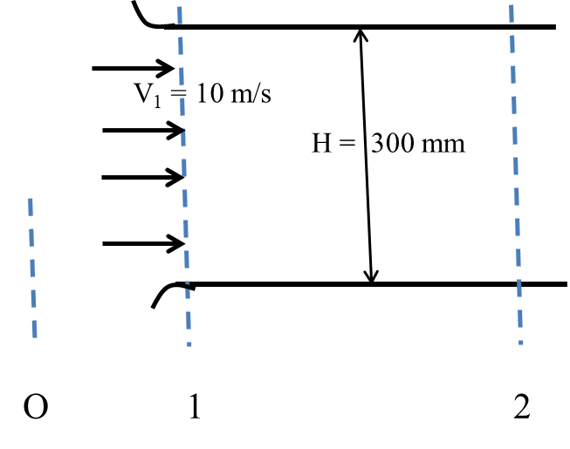

Slide 11
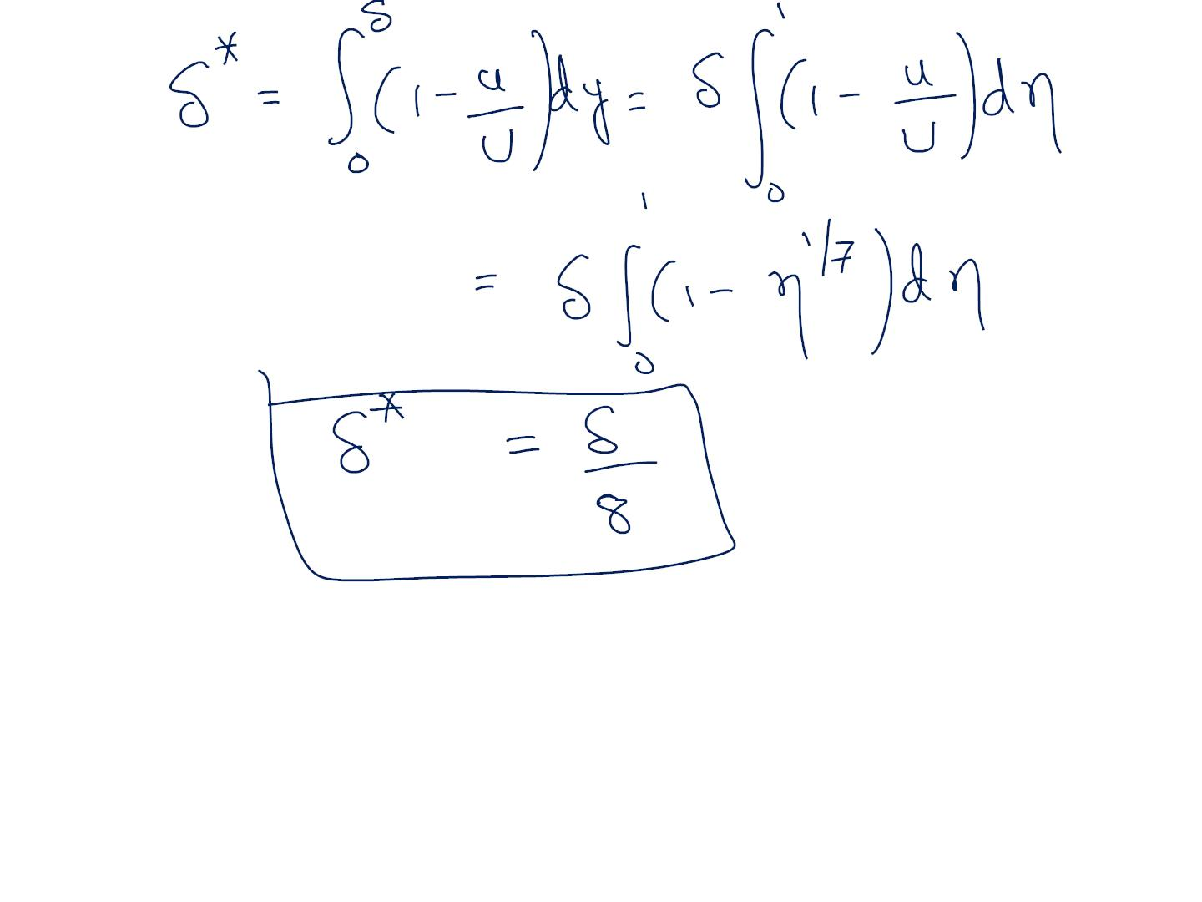

Slide 12
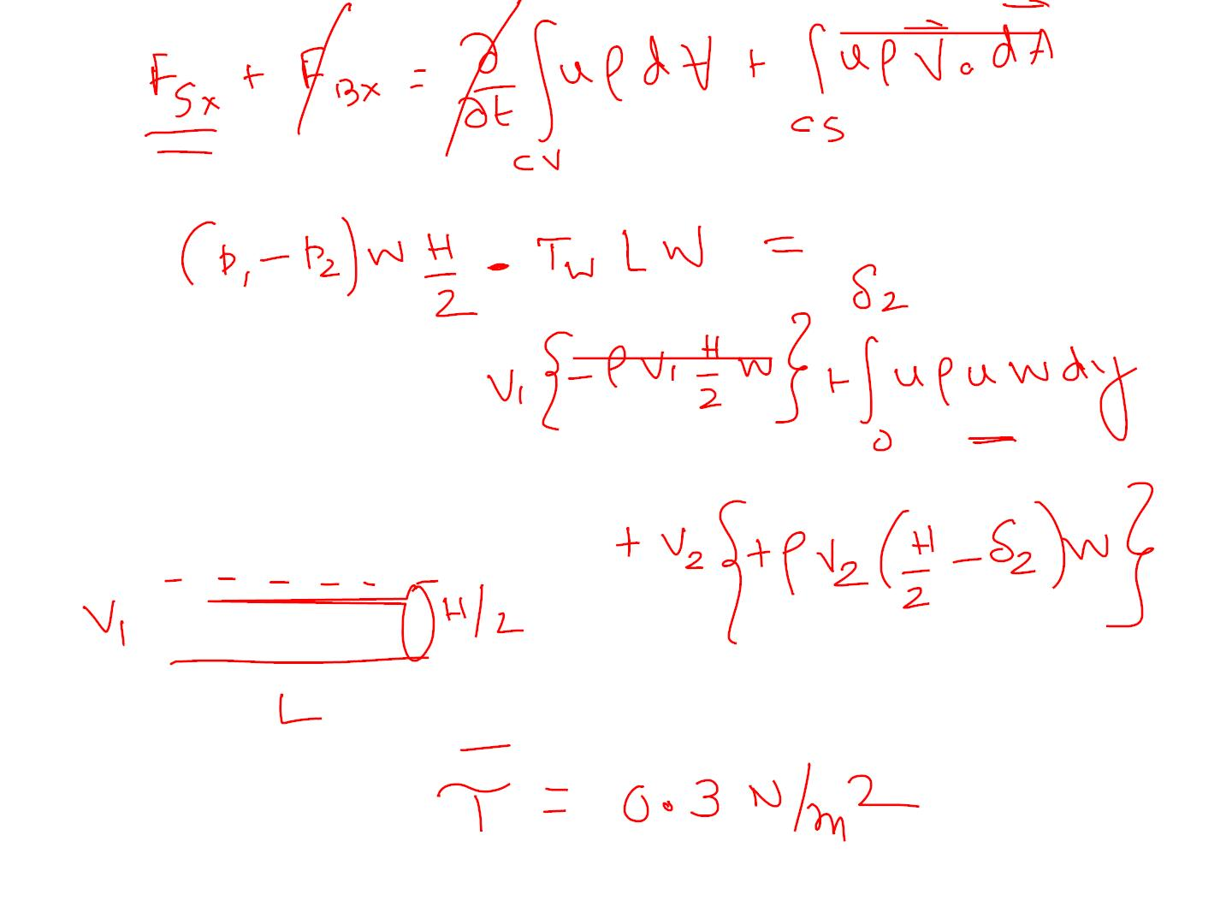

Slide 13
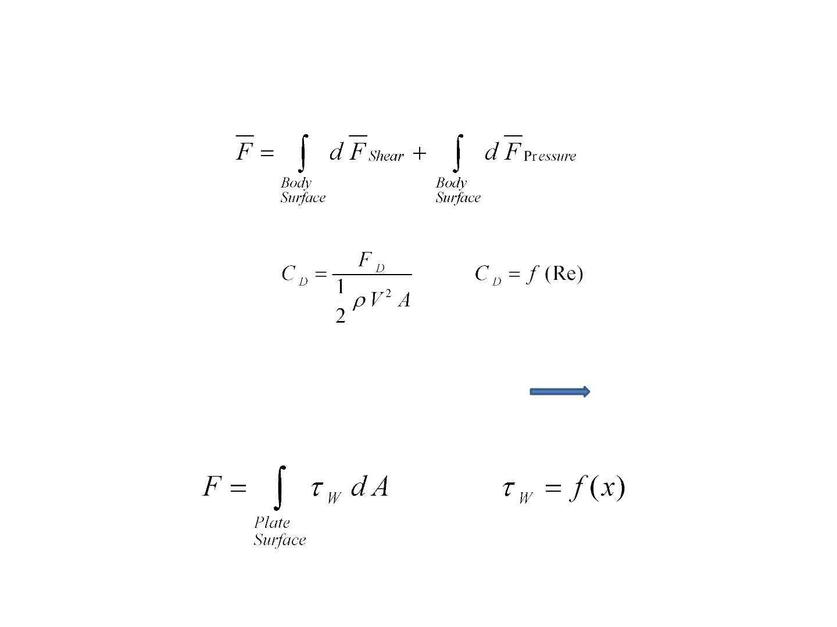
FluidꢀFlowꢀAboutꢀImmersedꢀBodies
Drag
FlowꢀoverꢀaꢀflatꢀplateꢀparallelꢀtoꢀtheꢀflowꢀꢀꢀꢀꢀꢀꢀꢀꢀꢀꢀꢀꢀꢀFrictionꢀDrag

Slide 14
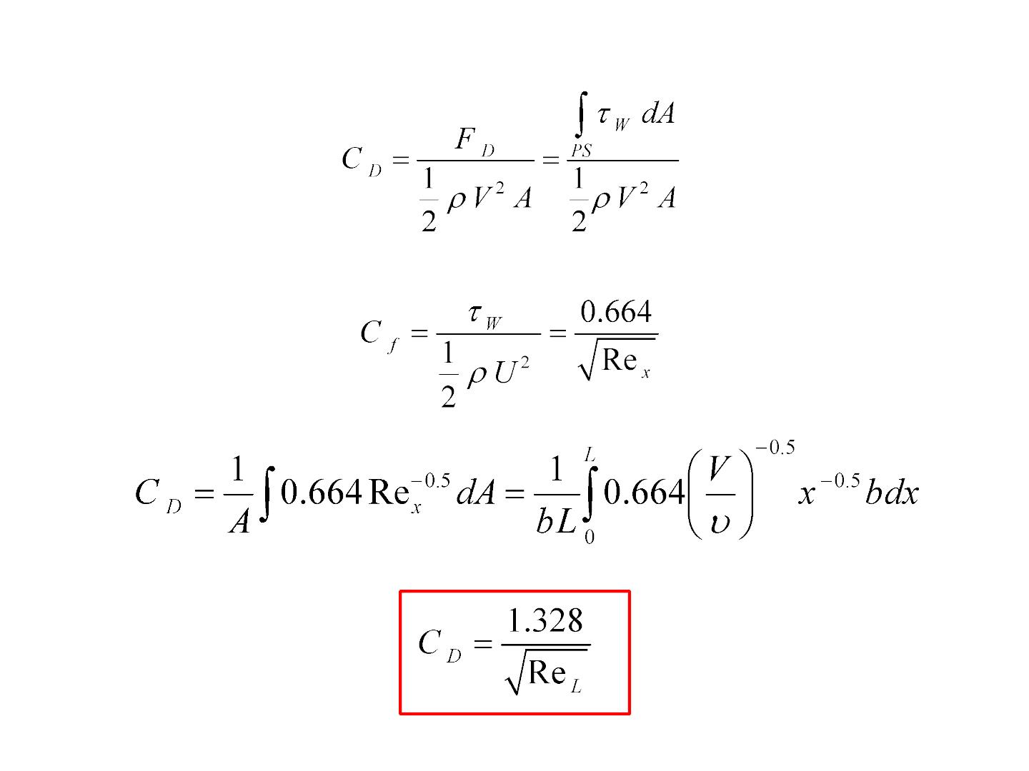
Forꢀlaminarꢀflow

Slide 15
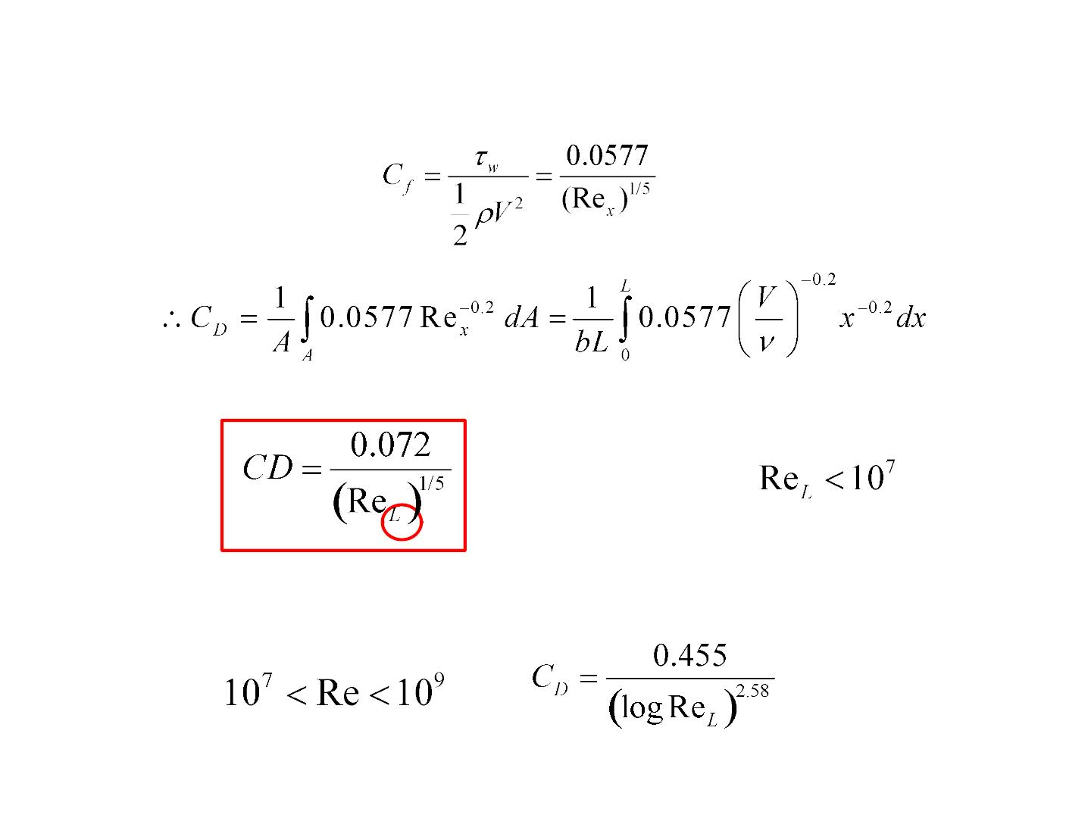
IfꢀtheꢀB.L.ꢀIsꢀturbulentꢀfromꢀtheꢀleadingꢀedge
TURBULENTꢀ
FLOW
EMPIRICAL

Slide 16
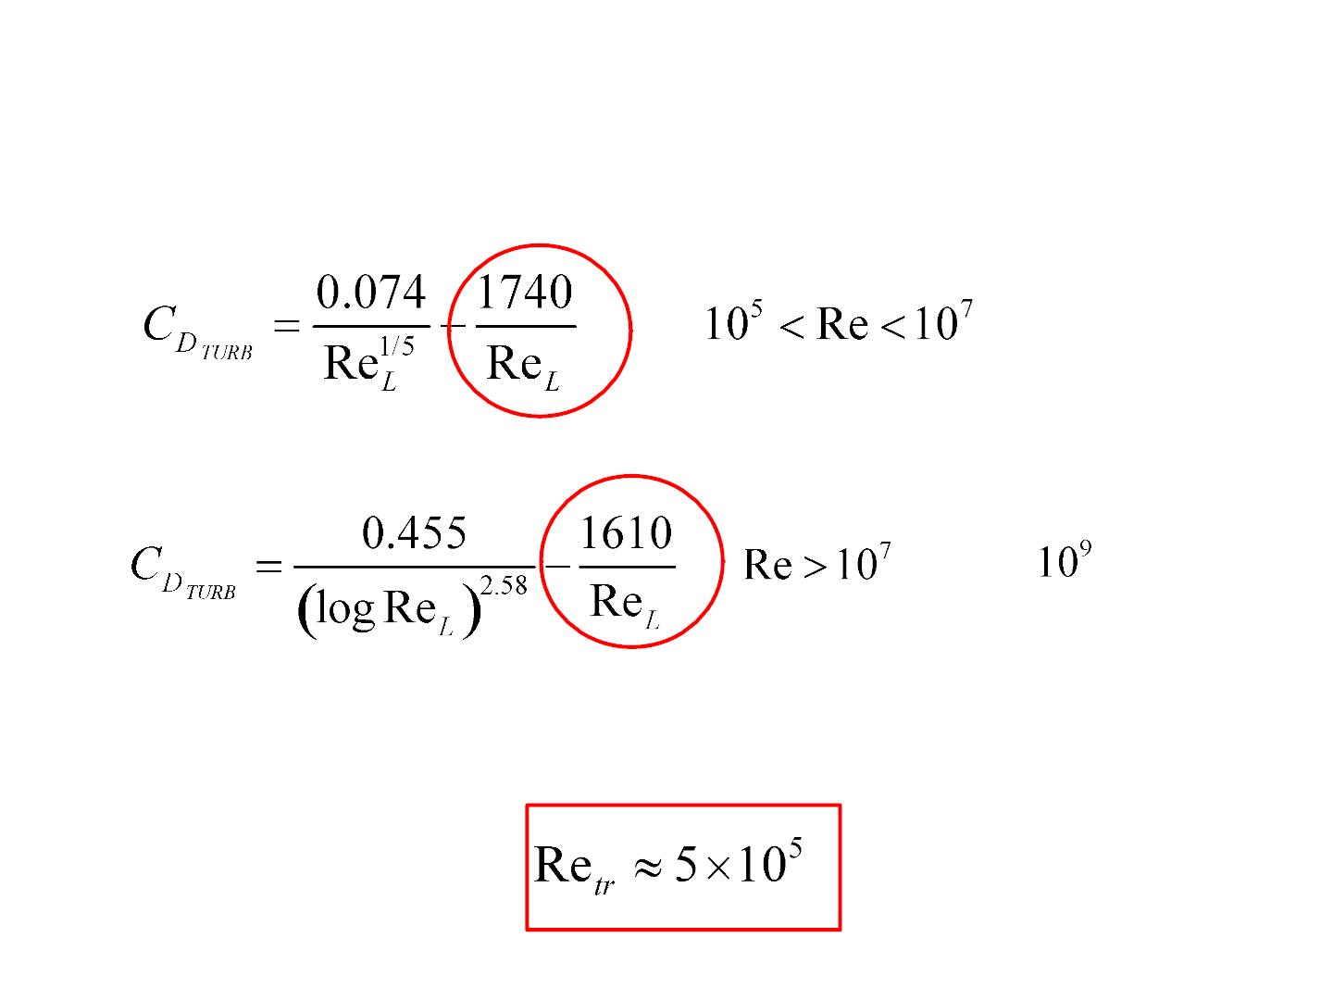
MIXEDꢀFLOW
Upꢀto
TRANSITIONꢀFROMꢀLAMINARꢀTOꢀTURBULENTꢀFLOWꢀTAKESꢀPLACEꢀATꢀA

Slide 17
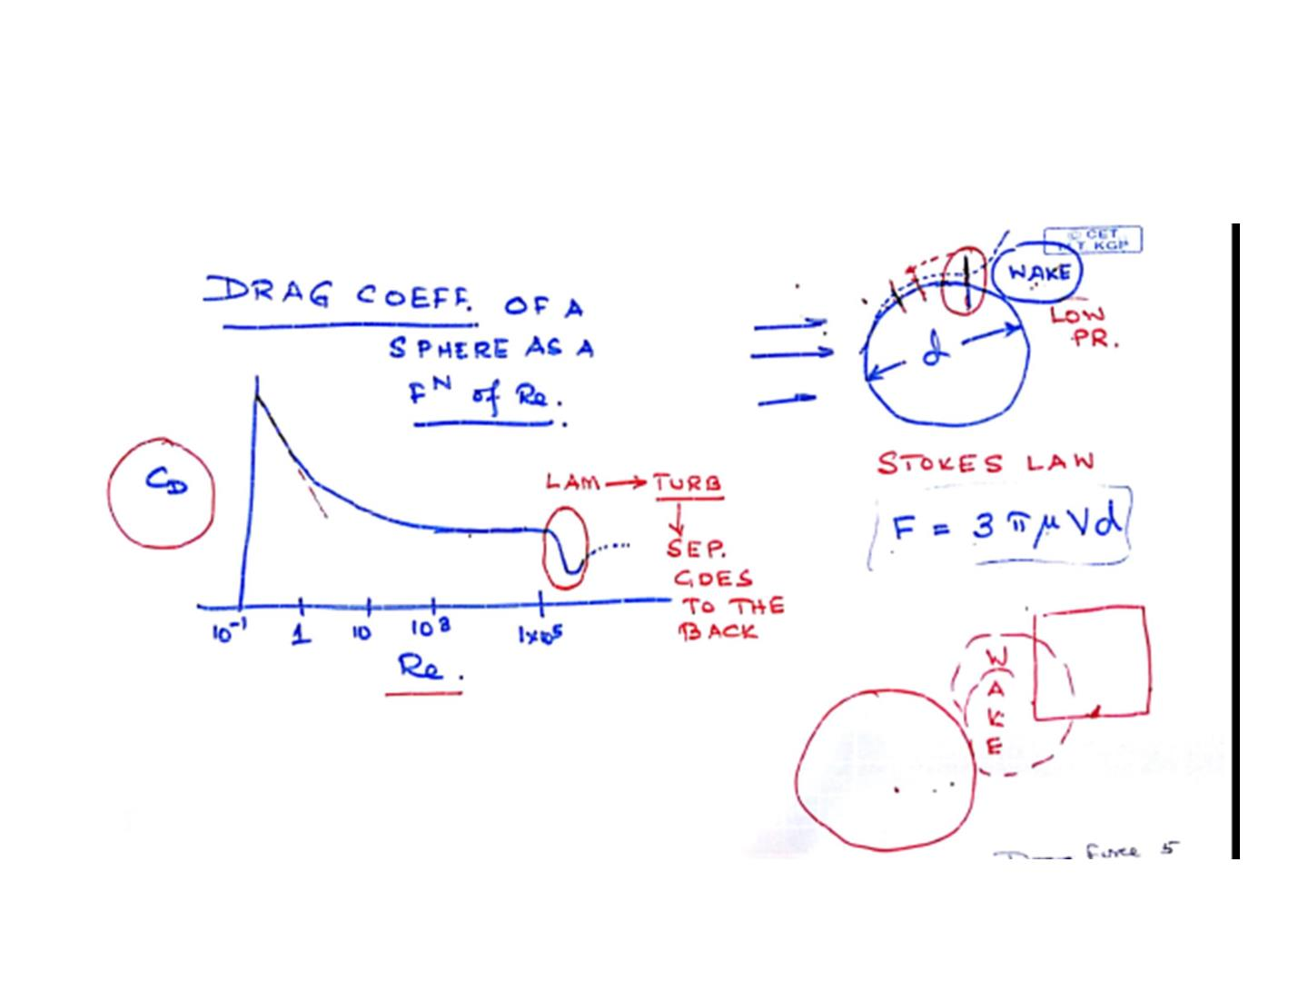

Slide 18
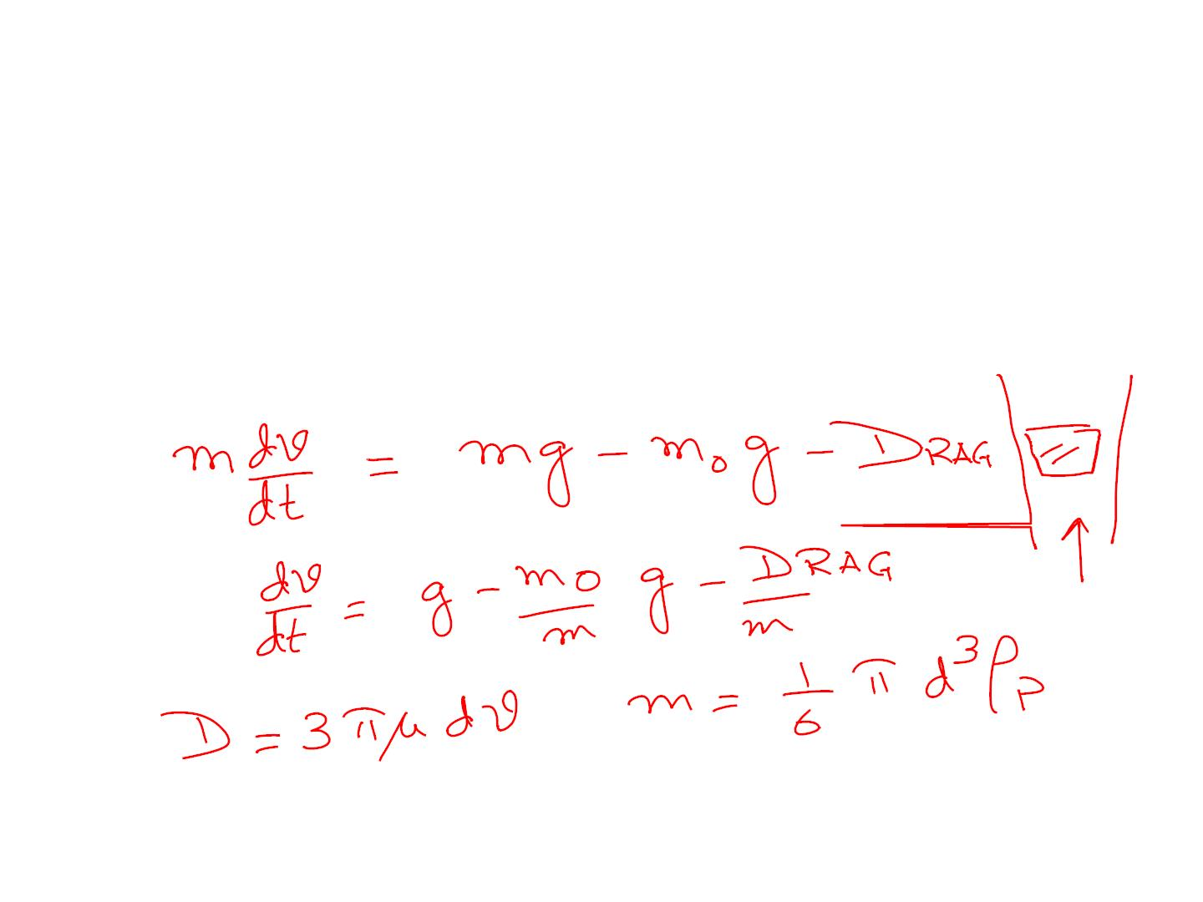
Aꢀparticleꢀ ofꢀ 1ꢀ mmꢀ diameterꢀ andꢀ densityꢀ ofꢀ 1.1ꢀ xꢀ 10³ꢀ kg/m³ꢀ isꢀ fallingꢀ freelyꢀ
fromꢀ restꢀ inꢀ anꢀ oilꢀ ofꢀ 0.9ꢀ xꢀ 10³ꢀ kg/m³ꢀ densityꢀ andꢀ 0.03ꢀ Nꢀ Sꢀ m^{–ꢀ 2}ꢀ viscosity.ꢀ
Assumingꢀ thatꢀ Stoke’sꢀ lawꢀ applies,ꢀ howꢀ longꢀ willꢀ theꢀ particleꢀ takeꢀ toꢀ reachꢀ
99%ꢀofꢀitsꢀterminalꢀvelocity?ꢀWhatꢀisꢀtheꢀReynold’sꢀnumberꢀcorrespondingꢀtoꢀ
thisꢀvelocityꢀandꢀwhyꢀisꢀthisꢀinformationꢀrelevant?

Slide 19
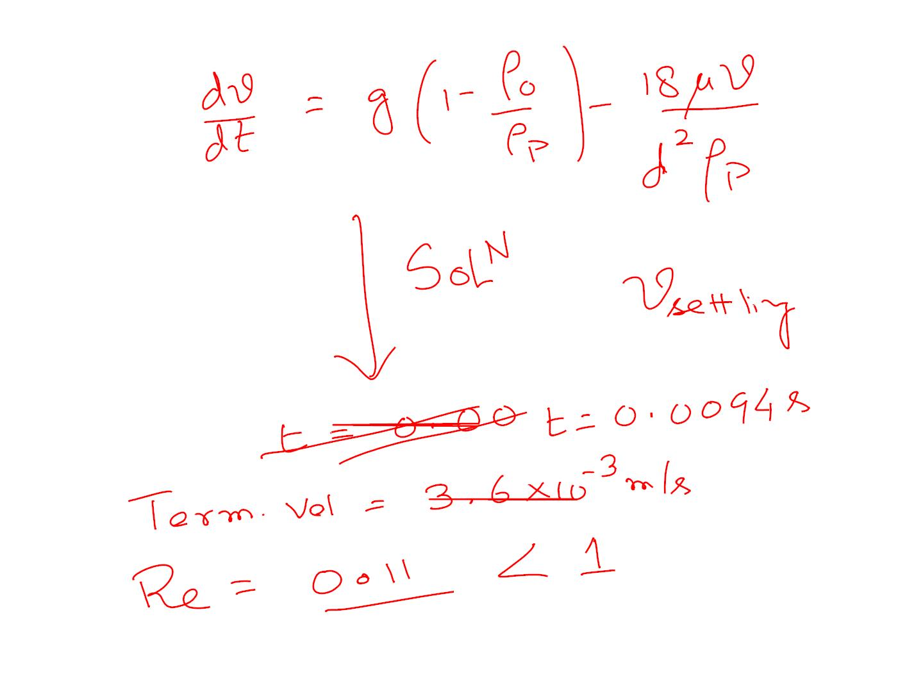

Slide 20

TransitionꢀfromꢀLaminarꢀtoꢀTurbulentꢀBoundaryꢀLayer

Slide 21
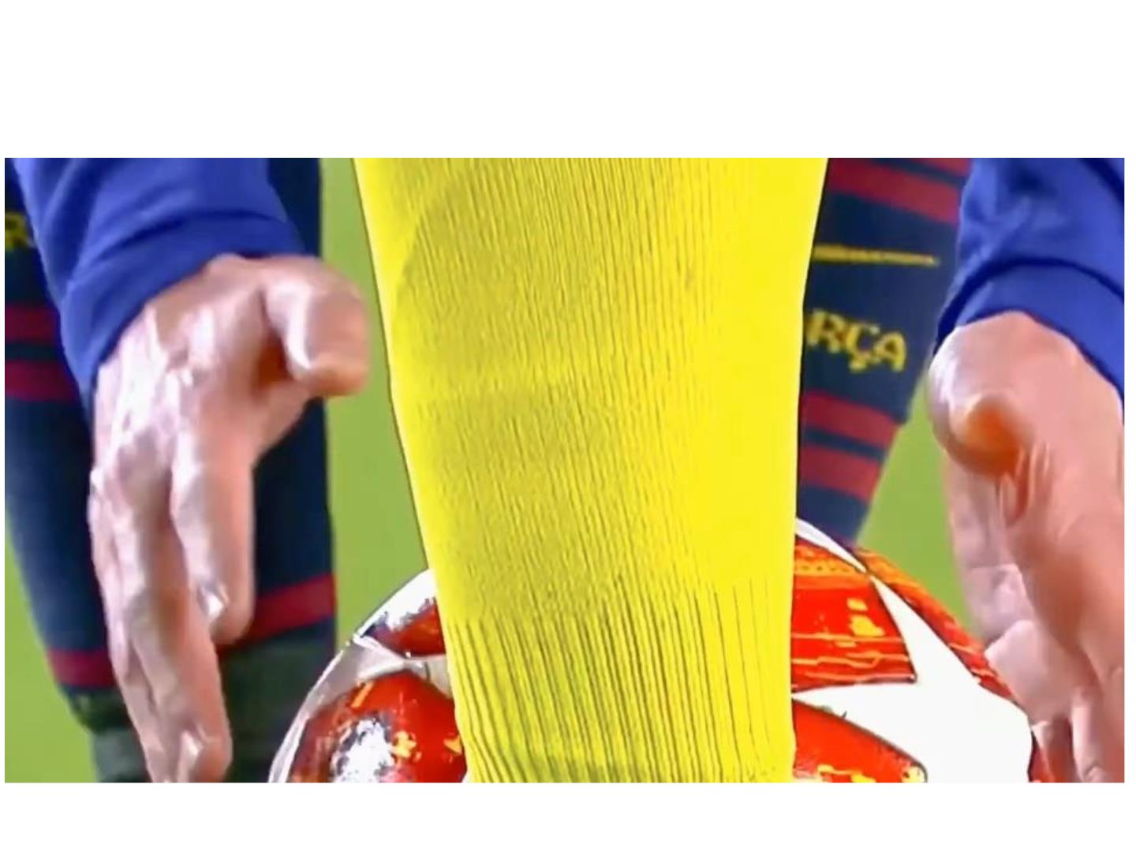
HowꢀdoesꢀMessiꢀdoꢀitꢀ?!!

Slide 22
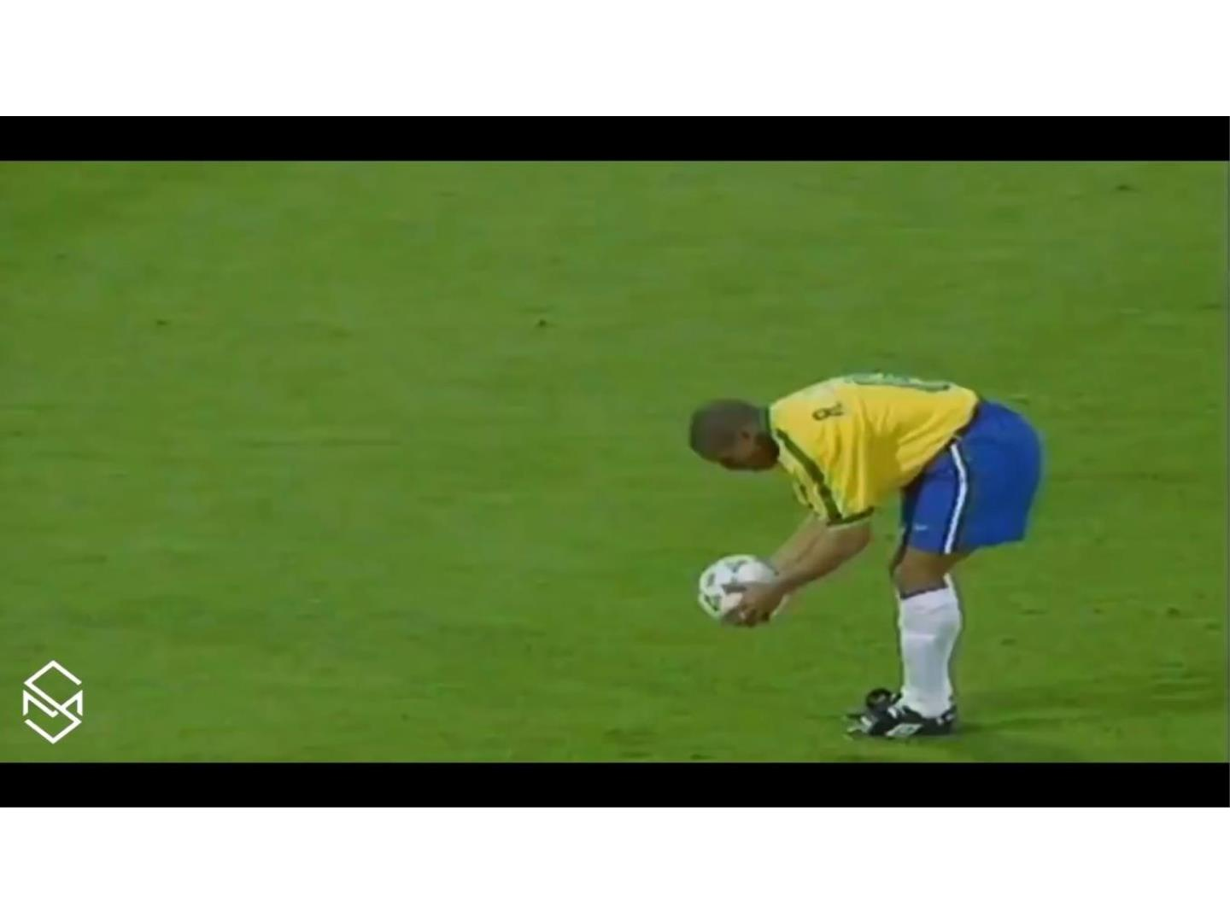
TheꢀBestꢀFreeꢀKickꢀEverꢀ(possibly)

Slide 23
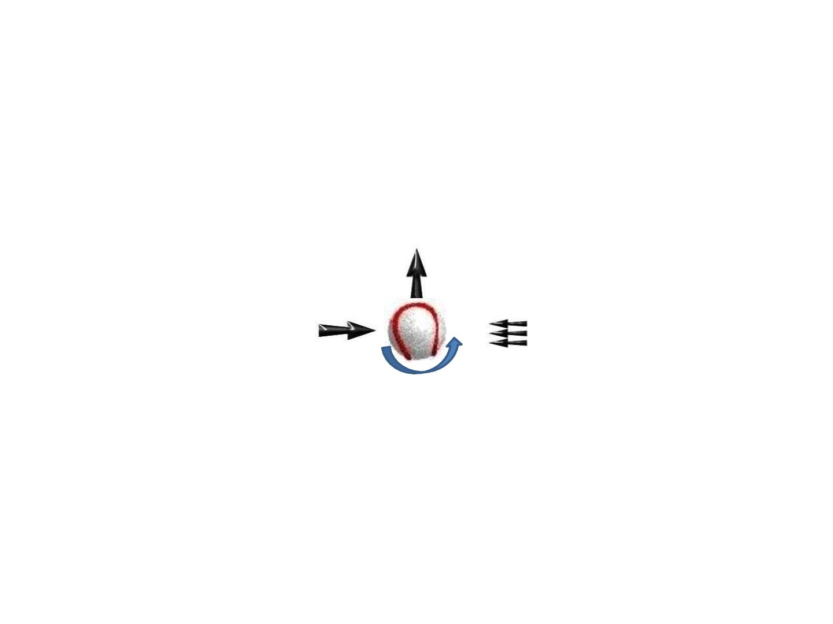
Aꢀspinningꢀballꢀcurvesꢀinꢀflightꢀꢀ---ꢀꢀtheꢀMagnusꢀEffect.ꢀThisꢀphenomenonꢀ
wasꢀ firstꢀ describedꢀ byꢀ Isaacꢀ Newton,ꢀ whoꢀ noticedꢀ thatꢀ inꢀ tennis,ꢀ topspinꢀ
causesꢀaꢀballꢀtoꢀdip,ꢀwhileꢀbackspinꢀflattensꢀoutꢀitsꢀtrajectory.
ꢀꢀꢀꢀꢀꢀꢀꢀꢀꢀꢀꢀMagnusꢀForce
ꢀꢀꢀ
Velocityꢀꢀꢀꢀꢀꢀꢀ
ꢀꢀ
ꢀꢀꢀꢀꢀꢀꢀꢀꢀꢀDrag
ꢀꢀꢀꢀꢀꢀꢀꢀꢀꢀꢀꢀꢀꢀꢀꢀꢀ
ꢀꢀꢀꢀꢀꢀꢀꢀꢀꢀꢀꢀꢀSpinningꢀballꢀ
Asꢀtheꢀballꢀrotatesꢀinꢀaꢀfreeꢀkick,ꢀtheꢀboundaryꢀlayerꢀcloseꢀtoꢀtheꢀsurfaceꢀisꢀ
pulledꢀ inꢀ theꢀ directionꢀ ofꢀ rotation,ꢀ leadingꢀ toꢀ delayedꢀ separationꢀ onꢀ thisꢀ
side.ꢀOnꢀtheꢀotherꢀside,ꢀtheꢀrotationꢀleadsꢀtoꢀearlierꢀseparation.ꢀThisꢀresultsꢀ
inꢀaꢀforceꢀthatꢀpushesꢀtheꢀballꢀsidewaysꢀtowardsꢀtheꢀareaꢀofꢀlowerꢀpressureꢀ
–ꢀtheꢀMagnusꢀForce.

Slide 24
Theꢀ playerꢀ kickingꢀ theꢀ ballꢀ appliesꢀ spinꢀ duringꢀ contact,ꢀ creatingꢀ rotationꢀ thatꢀ
makesꢀ theꢀ ballꢀ curve.ꢀ Forꢀ aꢀ right-footedꢀ player,ꢀ theꢀ “natural”ꢀ techniqueꢀ isꢀ toꢀ
brushꢀtowardꢀtheꢀoutsideꢀofꢀtheꢀball,ꢀcreatingꢀaꢀshotꢀorꢀpassꢀwithꢀaꢀright-to-leftꢀ
hook;ꢀaꢀleft-footedꢀplayer’sꢀ“natural”ꢀshotꢀwillꢀcurlꢀleft-to-right.

Slide 25
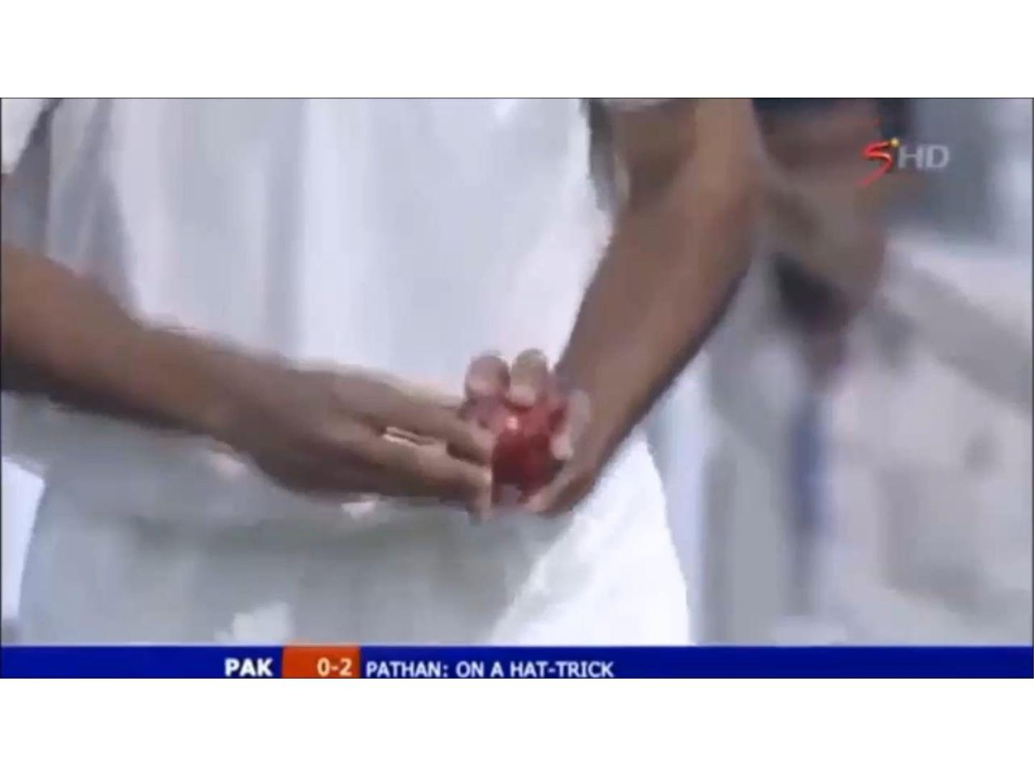
TheꢀSwingingꢀYorker

Slide 26
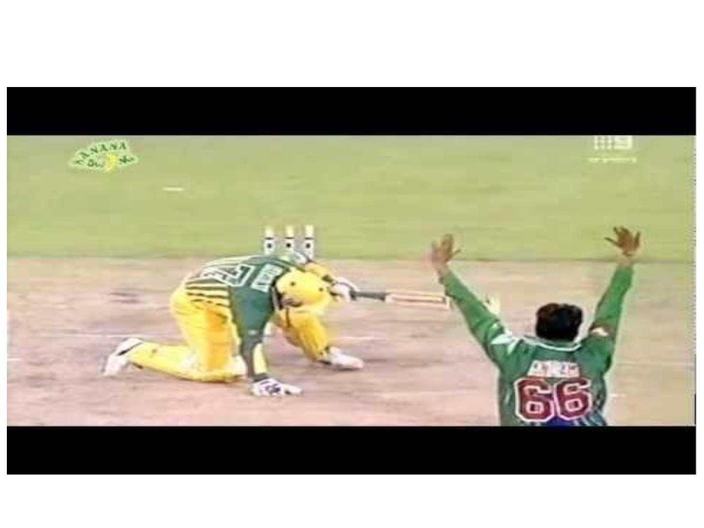

Slide 27
(a)ꢀTheꢀlaminarꢀtoꢀturbulentꢀtransitionꢀonꢀaꢀnewꢀcricketꢀballꢀ(ofꢀdiameterꢀ7.2ꢀcm)ꢀ
occursꢀatꢀaꢀRe_{D}ꢀofꢀaboutꢀ1.4x10⁵ꢀifꢀtheꢀflowꢀdoesꢀnotꢀencounterꢀtheꢀseam.ꢀButꢀitꢀ
canꢀbeꢀtriggeredꢀbyꢀtheꢀseamꢀe.g.,ꢀatꢀaꢀRe_{D}ꢀasꢀlowꢀasꢀ9.5x10⁴ꢀ(whenꢀitꢀisꢀatꢀ30ºꢀtoꢀ
theꢀairflow).ꢀUseꢀtheꢀaboveꢀinformationꢀtoꢀadviseꢀaꢀseamꢀbowlerꢀ(withꢀproperꢀ
reasons)ꢀaboutꢀtheꢀspeedꢀinꢀwhichꢀheꢀhasꢀtoꢀbowlꢀtoꢀachieveꢀswingꢀofꢀtheꢀball.ꢀTheꢀ
kinematicꢀviscosityꢀofꢀairꢀisꢀ1.5x10^{-ꢀ5}ꢀꢀm²/s.
(b)ꢀCricketꢀcommentatorsꢀoftenꢀtalkꢀofꢀlateꢀswingsꢀreferringꢀtoꢀballsꢀthatꢀswingsꢀ
unpredictablyꢀlateꢀinꢀflight.ꢀExplainꢀthisꢀphenomenonꢀbasedꢀonꢀtheꢀfollowingꢀfacts.ꢀ
Considerꢀaꢀcricketꢀballꢀofꢀmassꢀ0.156ꢀkgꢀandꢀdiameterꢀ7.2ꢀcm,ꢀbeingꢀbowledꢀatꢀaꢀ
speedꢀofꢀVoꢀ(greaterꢀthanꢀtheꢀupperꢀcriticalꢀspeedꢀofꢀtheꢀpreviousꢀproblem).ꢀIfꢀtheꢀ
dragꢀcoefficientꢀinꢀthisꢀsituationꢀisꢀconstantꢀatꢀ0.15,ꢀestimateꢀtheꢀvelocityꢀatꢀwhichꢀ
theꢀballꢀmustꢀbeꢀbowledꢀsoꢀthatꢀitꢀstartsꢀtoꢀlate-swingꢀatꢀaꢀdistanceꢀofꢀ15mꢀfromꢀtheꢀ
bowlingꢀend.ꢀFromꢀyourꢀcalculations,ꢀdoꢀyouꢀfeelꢀthatꢀaꢀswingꢀbowlerꢀcanꢀplanꢀhisꢀ
deliveryꢀforꢀaꢀlateꢀswingꢀorꢀwhetherꢀthisꢀdeliveryꢀisꢀjustꢀaꢀmatterꢀofꢀchance?ꢀGivenꢀ
ρ_{air}ꢀ=ꢀ1.22ꢀkg/m3.

Slide 28
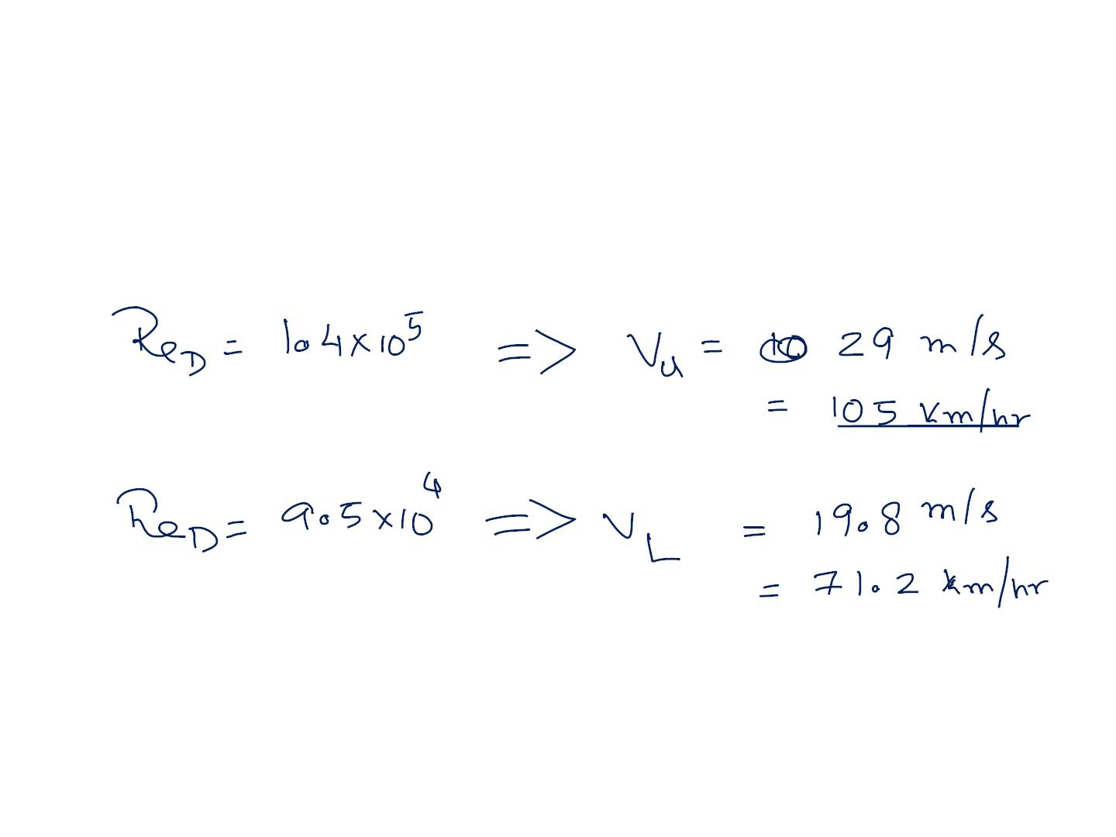
Theꢀ laminarꢀ toꢀ turbulentꢀ transitionꢀ onꢀ aꢀ newꢀ cricketꢀ ballꢀ (ofꢀ diameterꢀ 7.2ꢀ cm)ꢀ
occursꢀ atꢀ aꢀ Re_{D}ꢀ ofꢀ aboutꢀ 1.4x10⁵ꢀ ifꢀ theꢀ flowꢀ doesꢀ notꢀ encounterꢀ theꢀ seam.ꢀ Butꢀ itꢀ
canꢀbeꢀtriggeredꢀbyꢀtheꢀseamꢀe.g.,ꢀatꢀaꢀRe_{D}ꢀasꢀlowꢀasꢀ9.5x10⁴ꢀ(whenꢀitꢀisꢀatꢀ30^{oꢀ}toꢀ
theꢀ airflow).ꢀ Useꢀ theꢀ aboveꢀ informationꢀ toꢀ adviseꢀ aꢀ seamꢀ bowlerꢀ (withꢀ properꢀ
reasons)ꢀaboutꢀtheꢀspeedꢀinꢀwhichꢀheꢀhasꢀtoꢀbowlꢀtoꢀachieveꢀswingꢀofꢀtheꢀball.ꢀTheꢀ
kinematicꢀviscosityꢀofꢀairꢀisꢀ1.5x10^{-ꢀ5ꢀꢀ}m²/s.

Slide 29
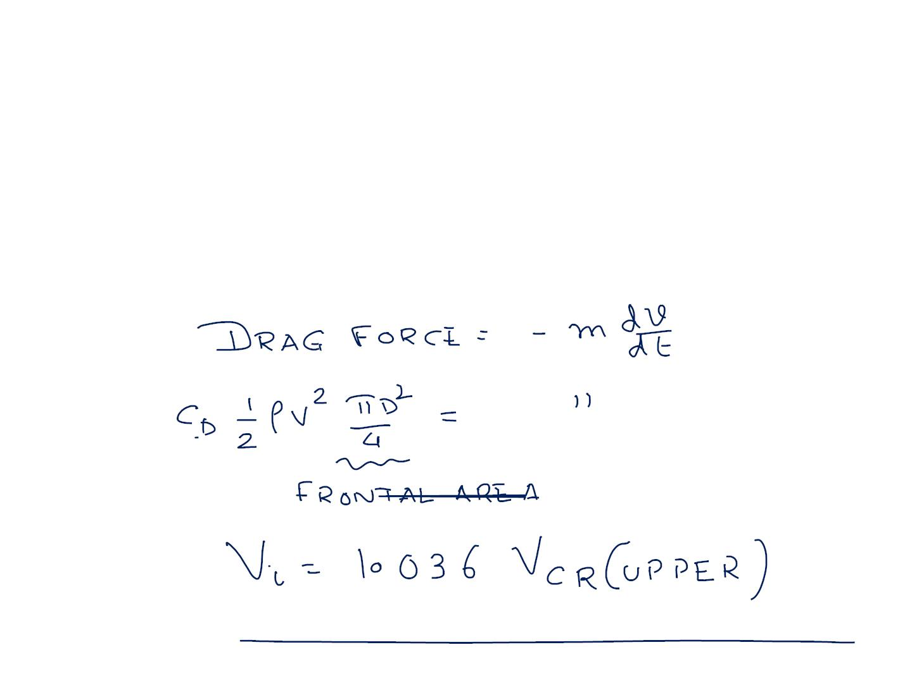
Cricketꢀcommentatorsꢀoftenꢀtalkꢀofꢀlateꢀswingsꢀreferringꢀtoꢀballsꢀthatꢀswingsꢀ
unpredictablyꢀlateꢀinꢀflight.ꢀExplainꢀthisꢀphenomenonꢀbasedꢀonꢀtheꢀfollowingꢀ
facts.ꢀConsiderꢀaꢀcricketꢀballꢀofꢀmassꢀ0.156ꢀkgꢀandꢀdiameterꢀ7.2ꢀcm,ꢀbeingꢀbowledꢀ
atꢀaꢀspeedꢀofꢀVoꢀ(greaterꢀthanꢀtheꢀupperꢀcriticalꢀspeedꢀofꢀtheꢀpreviousꢀproblem).ꢀIfꢀ
theꢀdragꢀcoefficientꢀinꢀthisꢀsituationꢀisꢀconstantꢀatꢀ0.15,ꢀestimateꢀtheꢀvelocityꢀatꢀ
whichꢀtheꢀballꢀmustꢀbeꢀbowledꢀsoꢀthatꢀitꢀstartsꢀtoꢀlate-swingꢀatꢀaꢀdistanceꢀofꢀ15mꢀ
fromꢀtheꢀbowlingꢀend.ꢀFromꢀyourꢀcalculations,ꢀdoꢀyouꢀfeelꢀthatꢀaꢀswingꢀbowlerꢀ
canꢀplanꢀhisꢀdeliveryꢀforꢀaꢀlateꢀswingꢀorꢀwhetherꢀthisꢀdeliveryꢀisꢀjustꢀaꢀmatterꢀofꢀ
chance?ꢀGivenꢀρairꢀ=ꢀ1.22ꢀkg/m3.

Slide 30
WithꢀaꢀvalueꢀsoꢀcloseꢀtoꢀtheꢀV_{upperꢀ}theꢀlateꢀswingꢀisꢀmoreꢀofꢀaꢀmatterꢀofꢀchance

